Slide 1
REAL TIME PRICING
INDUSTRY BRIEFING
8th May 2018

Slide 2
Agenda
Time | Topic |  | Presenter | Duration
9:00am | Coffee/Tea and assemble for briefing
9:15am | Welcome / Health and Safety Introduction | Tim Street (Electricity Authority) / John Clarke (Transpower) | Tim Street (Electricity Authority) John Clarke (Transpower) | 10 minutes
9:25am | Current status and general overview of feedback | Justin Wood (Electricity Authority) | Justin Wood (Electricity Authority) | 20 minutes
9:45am | Programme Overview | Daniel Crawshay (Transpower) | Daniel Crawshay (Transpower) | 15 minutes
10:00am | Engaging with the industry | Daniel Crawshay (Transpower) | Daniel Crawshay (Transpower) | 10 minutes
10:10am | Morning Tea |  |  | 20 minutes
10:30am | Market System Outages | Phil Yao (Transpower) | Phil Yao (Transpower) | 15 minutes
10:45am | Instantaneous Reserve (IR) deficits | Murray Henderson (Transpower) | Murray Henderson (Transpower) | 15 minutes
11:00am | High Spring Washer Pricing Situations | Hamish McKinnon / Duncan Buchanan (Transpower) | Hamish McKinnon (Transpower) Duncan Buchanan (Transpower) | 20 minutes
11:20am | Recasting dispatch-lite | Justin Wood (Electricity Authority) | Justin Wood (Electricity Authority) | 20 minutes
11:40am | Price Error Claims (PEC) | Murray Henderson (Transpower) | Murray Henderson (Transpower) | 15 minutes
11:55pm | Questions from the floor and wrap up | Daniel Crawshay & Murray Henderson (Transpower) Justin Wood & Tim Street (Electricity Authority) | Daniel Crawshay & Murray Henderson (Transpower) Justin Wood & Tim Street (Electricity Authority) | 20 minutes
12:15pm | Light Lunch and End

Slide 3
Welcome and Introduction
Session being videoed and will be published
Purpose of this session is to advise of how feedback has been incorporated
  Brief you on the decisions that have been made
  Immediate process from here (make a recommendation of the code amendments to the board)
  Overview of how the whole project will go from here
  Start the discussion on how we engage with you
  Note the project has over three years to run, anticipate more discussion and input will be required
  Interested in any significant oversights of gaps in our thinking
  Key points for industry to think about in regards to the world under RTP
  What changes
  What doesn’t change

Slide 4
Current status and general overview of feedback
Presenter : Justin Wood

Slide 5
Current overall status after considering submissions
Most core design elements ‘upheld’
some reworked

☑
a few deferred
➲

Slide 6
Current overall status after considering submissions
We want to consult further on some design elements or their details:
  ‘non-core’ aspects >>> no delay to build
    actual dollar amount for default scarcity pricing values
    possible Code process for reviewing these
    detailed treatment of reserve shortfall
    pricing (CVPs)
    materiality for pricing errors
    dispatch-‘lite’
a few deferred
➲

Slide 7
Current overall status after considering submissions
In response to questions and suggestions:
  modified approach to pricing errors
  re-examined in depth but
  not modified proposal:
    high spring-washer situations
    market system outages
some reworked


Slide 8
Summarising submitters’ views in three categories
Broadly supported design as proposed
Support but queried
Suggested changes or poorly supported
✓
⬧


Slide 9
Design elements broadly supported
Real-time pricing derived from real-time dispatch schedule
Interim prices the time-weighted average of dispatch prices visible on WITS in trading period
  Clarifying: dispatch prices apply from the moment they’re visible until replaced
Pricing manager disestablished; clearing manager
calculates interim prices
✓

Slide 10
Design elements broadly supported
Assign default scarcity pricing values to all unbid demand in three blocks
  Clarifying: non-conforming loads keep doing exactly what they do now
Disconnected nodes assigned a proxy price
  Further work: system operator now proposing
  using price of the electrically-nearest live node
Partially relax reserve cover before instructing emergency load shedding
✓

Slide 11
Design elements broadly supported
Move to bottom-up load forecast using ION meters as primary input
  Further work: system operator to document short-term load forecast process
Dispatchable demand moves to the real-time dispatch schedule
  Further work: develop guidance and education on DD
Rebidding and reoffering within the trading period
(under same restrictions as today)
✓

Slide 12
Design elements broadly supported
Constrained payments use last good offer/bid in trading period
Retain a pricing error process
Pricing falls back to PRS during market system outages
✓

Slide 13
Design elements broadly supported
Forward schedules aligned with dispatch schedules
Loss & constraint excess apportioned from dispatch schedules
Discontinue current 5-minute ex-post ‘RTPs’
✓

Slide 14
Design elements raising queries
The exact dollar amounts of default scarcity pricing values
Default scarcity pricing blocks binding before higher-priced generation or dispatchable demand
The system operator’s process for instructing distributors
to shed load
  Further work: better clarity on operational practises
⬧

Slide 15
Design elements raising queries
Removing the cumulative price limit
  Clarifying: the limit does not guarantee lower prices today; it does not restrain the financial impact of shortage
Removing intervention for high spring-washer situations
⬧

Slide 16
Design elements raising queries
Pricing when partially relaxing reserve cover
Manual pricing error claims investigated by the system operator
  Clarifying: the Authority will decide after considering advice (same as today)
⬧

Slide 17
Design elements poorly supported or suggested alternatives
Introducing a dispatchable-demand ‘lite’ for small purchasers
  Request: let distributed generators use it too
Only manual claims for pricing errors


Slide 18
In summary
Most core design elements ‘upheld’
some reworked
pricing error
HSWS
MS outages
a few deferred
scarcity pricing $
reserve shortfall CVPs
dispatch-lite

Slide 19
Programme Overview
Presenter : Daniel Crawshay

Slide 20
Programme Approach to RTP
Notes:
RTP is a large and complex change
The Authority and system operator are working collaboratively across five key change areas
System operator will be owning and leading the significant changes required to it’s internal systems and tools and the changes to it’s business model including all the changed and new processes procedures and policies required to support real time pricing.
The system operator and Electricity Authority will be working together to ensure that the industry has the information it needs in a timely manner to affect any changes as may be required to participants systems and processes and will be engaging regularly through the life of the programme to ensure information and ideas are shared in as a collaborative way as possible.
The Authority will engage other service providers that will require to make changes to their systems and processes to enable, or accommodate, the changes being made to bring in real time pricing as required. As noted on the diagram, there will critical dependencies between these changes and the work the system operator is doing, these dependencies will be jointly managed by all involved parties and overseen by the Authority and system operator.
Finally, there are significant code changes and some required to internal processes with the Authority to allow real time pricing, these changes will be managed by the Authority.

Slide 21
Project Timelines
Notes:
Following industry consultation in 2016 and 2017 and assuming approval to proceed is given in the appropriations decision due this month the delivery phase of the project is planned to commence in June 2018.
There are a few items from the 2017 consultation that generated some questions, these will discussed over the course of this morning.
The project is expected to take 37 months to deliver real time pricing, with an additional 6 months effort following deployment to remove superfluous functionality and complete decommissioning.
At the start of the delivery phase the detailed solution requirements and a high level design for system changes will be completed, detailed business process changes and training needs will also be confirmed.
On completion of the high level design further confirmation will be sought that the project should continue by way of the delivery business case.
A four stage delivery approach is then planned, the first three stages update the required functionality to support RTP with RTP commissioning at the end of phase three. The final stage removes superfluous functionality as mentioned earlier.
Details of the content of each of the three functional stages was provided in the authority’s consultation information in August 2018.
Current indicative planning gives a stage three (RTP functionality) delivery timeline of Mid 2021. This will be confirmed through the next phase of the project.
Design information will be shared with industry at the end of phase 2 (approx. April 2020) which will enable you to commence changes to your systems and processes.

Slide 22
Market Design Summary
Significant effort in the design to date
Confidence in the approach being taken
Expect there to be issues identified as the project progresses
Will be engaging with industry
Accept there will need to be flexibility and possibly revision
The best way forward will be progressed
Notes:
We know that this is a long and complex project, whilst there has been significant effort put into the market design of real time pricing to date, including two rounds of industry consultation, and we are confident enough in our findings to recommend progressing to the delivery phase we are not arrogant enough to assume we have identified everything and have the perfect solution.
We know from experience these types of projects throw up issues and unexpected complexities, we expect there to be a degree of flexibility required and may well be areas where a revised approach may be required, we will engage with industry, you guys, through the project and keep you informed of progress as well as issues that we would like your input on.
We will be talking to you about how we work with industry later on today.

Slide 23
Engaging with Industry
Presenter : Daniel Crawshay

Slide 24
Engaging with Industry
How would you prefer to be kept involved in the Real Time Pricing project?
Our ideas include:
Something Similar to the Reserves and Frequency Management (RFM) programme and the National Market for Instantaneous reserves (NMIR) project
  Six Monthly all of industry briefings – possibly part of the Transpower customer briefings
  An industry engagement group of keenly interested industry representatives, called as and when needed or useful
Publication of case studies and worked examples – i.e. how specific events would be expected to play out under Real Time Pricing
Publication of information and regular progress on the system operator and/or Electricity Authority websites.
Any other ideas? Will take these onboard at the end of the session.

Slide 25
Market System Outages
Presenter : Phil Yao

Slide 26
RTP Consultation - Q20
Section 3.107 Proposed approach when there is a Market System (MS) outage
the last published dispatch price would stand until the end of the trading period,
if a dispatch price is not published at the beginning of a trading period, the latest price from the PRS for the trading period would apply.
Q20. Do you agree with the proposed treatment of spot prices during MS outages? If not, please explain your reasoning.
Yes
  ……there does not seem to be any other practical alternative…………
  ……cannot think of a better method………..
but recommend further work

Slide 27
MS Outages: Potential Impacts on RTP
Why outages are required
What the outages are (Nov/16 – Jan/18)
  Inter-site switchover
Potential Impacts on RTP
Peer approach (PJM and AEMO)
Options to mitigate the impacts of outages

Slide 28
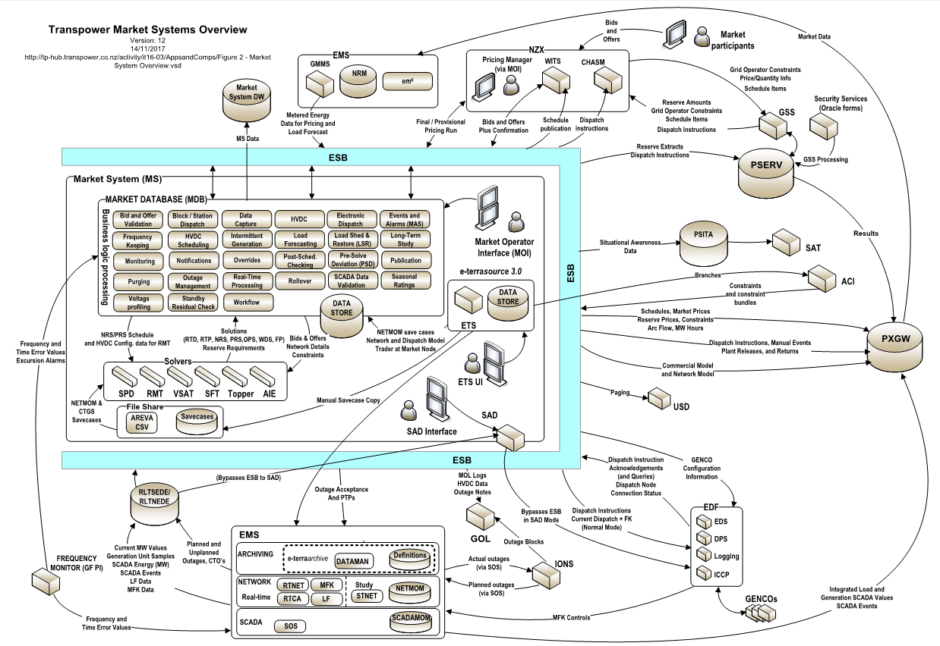
Why – MS was designed in early 2000s
not to invest in an always ‘up’ system
Standalone Dispatch (SAD) - a simplified version of the MS allowing core functions to be performed
NDC
SDC
Replication
Primary
Standby

Slide 29
Summary of MS outages (Nov/16 – Jan/18)
Between November 2016 and January 2018, there were:
112 days (87.5%) when Market System changes or system patching occurred without the need for an outage.
16 days (12.5%) when Market System changes or inter-site switchovers occurred which needed an outage
  12 outages were completed within 1 hour, including 7 outages that took less than 30 minutes.

Slide 30
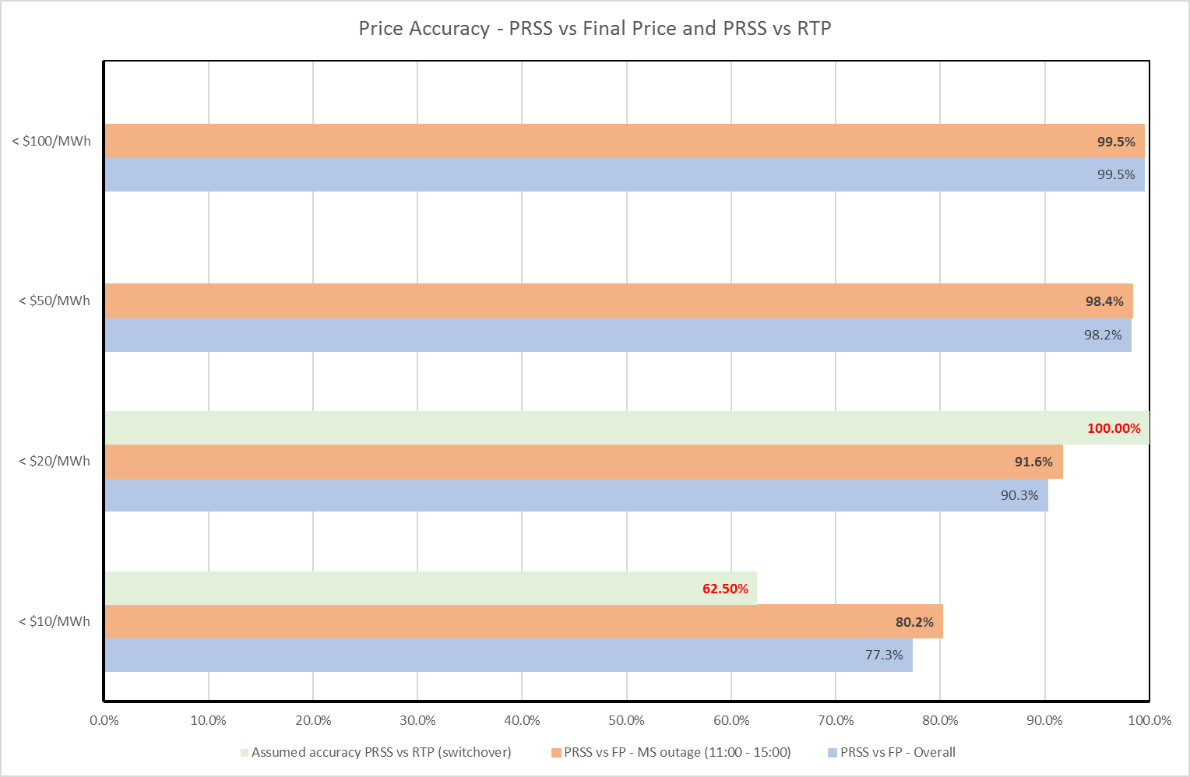
PRSS vs FP vs RTD at HAY2201 (Nov/16 – Jan/18)
PRSS vs FP - PRSS prices predict FP reasonably accurately (average difference $8.7/MWh)
77.3% of the time when the differences between PRSS and FP are within $10/MWh
90.3% within $20/MWh
MS outage window - less grid activity and more stable wholesale prices, showing the increase of accuracy to
80.2% within $10/MWh;
91.6% within $20/MWh.
PRSS vs RTD – for all planned inter-site switchovers (8 trading periods), average difference $5.5/MWh with the maximum difference $14/MWh

Slide 31
Peer Approaches
  PJM (time-consuming process)
  uses a manual dispatch process and only sends zonal dispatch rates
  recreates the pricing tool case after system restoration
  AEMO (may suspend the market)
  applies the most recently published pre-dispatch schedule until it is no longer possible to continue to dispatch, sets energy and ancillary prices by using Market Suspension Pricing Schedules (calculated and published by AEMO weekly) in the event of market suspension,
  gives market participants a minimum of two hours’ notice before the proposed change back.

Slide 32
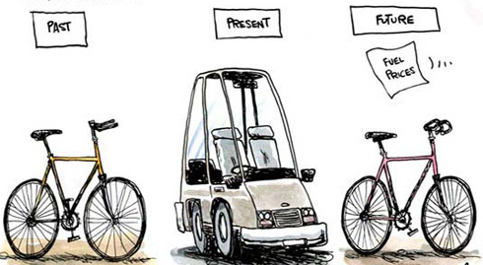


Options to Mitigate the Impacts of Outages
  Option A: A Logical Market System
  This solution uses independent (including non-oracle technology that AEMO uses) technology to create a single or multiple node logical instance of the Market System.
  The effort and impacts of implementing Option A are rated high.
Option B: RTP from SAD (Cut Down Solution)
This solution enables SAD to calculate and publish RTP prices.
The effort and impacts of implementing Option B are rated medium.
Option C: RTP from SAD (Full Solution)
This solution would extend SAD even further than Option B. With Option C, SAD will incorporate SDV and have the ability to receive the latest bids and offers.
The effort and impacts of implementing Option C are rated high.
significant capital and ongoing operational cost

Slide 33
Conclusions – NO Change
Market System datastore and the current application code were designed in the early 2000s,
Transpower always attempts to minimise the occurrence and duration of outages e.g. only 12.5% of the changes required an outage between Nov 16 and Jan 18,
Market System outages are infrequent events normally take less than 1 hour to complete,
Market System outages are scheduled when there is less grid activity and stable prices,
PRS prices predict FP and potentially RTP prices relatively accurately assumed no participants’ behaviour changes,
peer approaches could be time-consuming or requiring a market suspension,
the effort and impacts of implementing the three options to mitigate the implications of MS outages are rated medium and high,
Future work could be done to investigate what type of outages are more suitable for the industry e.g. would the industry prefer less frequent but longer outages or more frequent but shorter outages.

Slide 34
Instantaneous Reserve (IR) deficits
Presenter : Murray Henderson

Slide 35
IR deficits – current state
Prioritises energy ahead of Contingent Event (CE) IR
  Relaxation is the ‘optimal outcome’
Sends price signals
Ex-ante tidy-up – Virtual Reserve Provider (VRP)

Slide 36
IR deficits – current state
Notes:
Add in highest ever offer $

Slide 37
IR deficits – RTP
Why is change required?
Notes:
Why do we need to do anything? Then make graph appear and morph to the lowest scarcity bid version. Make words disappear when graph appears.

Slide 38

IR deficits – RTP
To be confirmed
2nd RTP consultation
Lots of good ideas – viable options!

Slide 39
IR deficits – RTP
$ignals
physical

Slide 40
IR deficits – RTP
physical
$ignals

Slide 41
IR deficits – RTP
Options investigated:
Change only the CE IR CVPs
Create a new CE IR CVP for concurrent FIR and SIR deficits
Change the CE IR CVPs and adjust quantities

Slide 42
IR deficits – RTP option analysis
Example based comparative
Option vs option
CVP values

Slide 43
IR deficits – RTP option analysis

Slide 44
IR deficits – RTP
Worth remembering the original issue is a lack of offers.

Slide 45
High Spring Washer Price Situations
Presenter : Hamish McKinnon & Duncan Buchanan

Slide 46
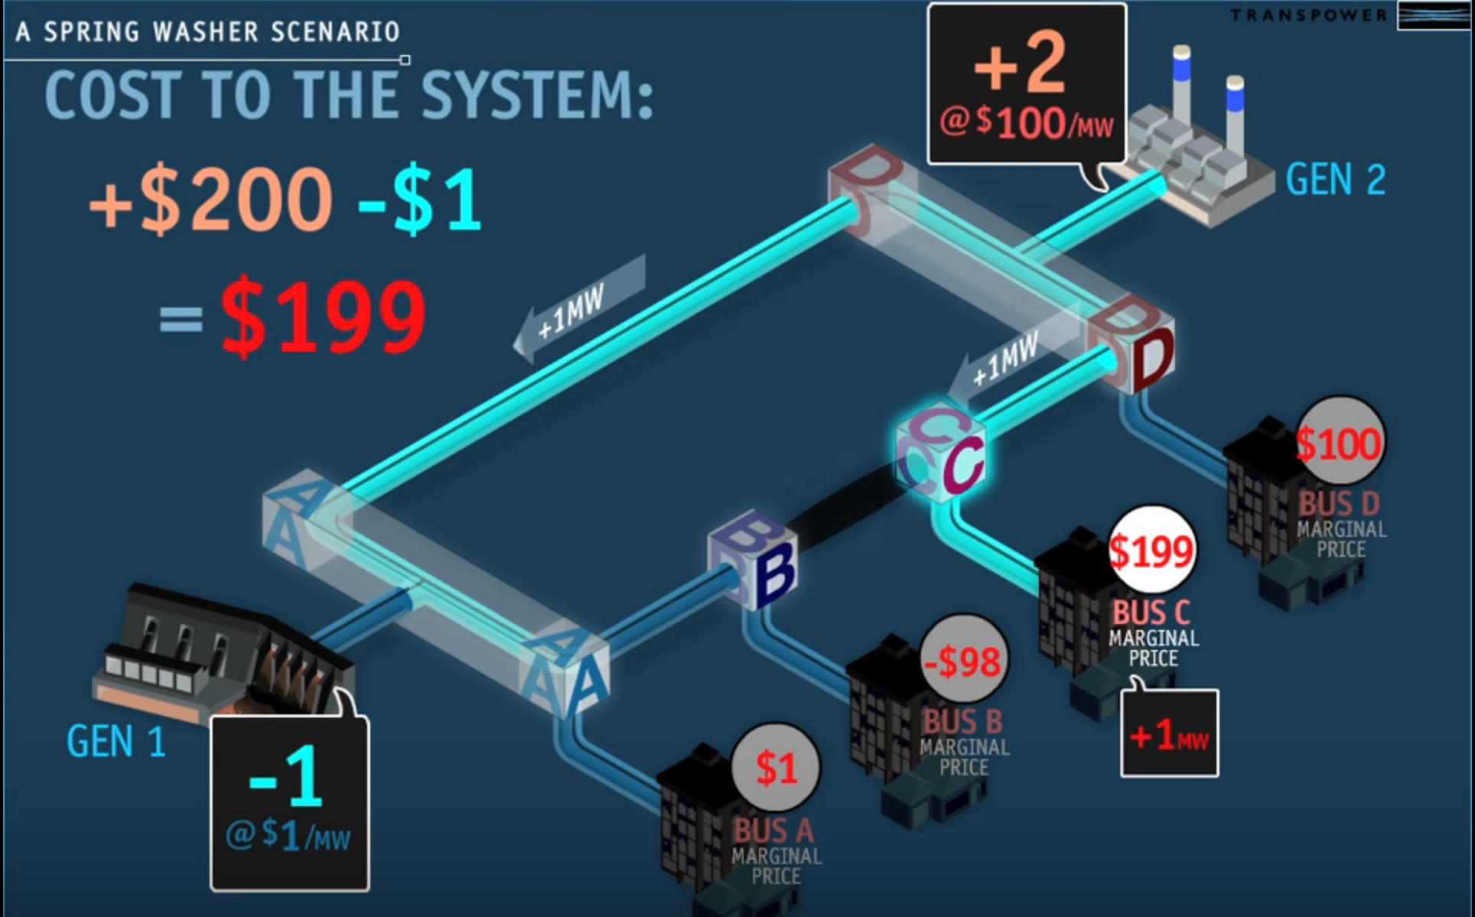
High Spring Washer Price Situations

Slide 47
Current High Spring Washer Price Situations
Two requirements…
A binding transmission constraint
Resultant GXP prices greater than 5x the highest cleared [energy] offer price
…which aren’t necessarily linked
‘false positive’ pricing can result e.g. reserve prices relatively far in excess of energy prices, at the same time as a binding constraint

Slide 48
High Spring Washer Price Situations
Currently happen infrequently
  Fewer than 20 trading periods per year are affected
SPD calculation is tested
  A relaxation factor is applied to the constraint RHS to avoid effects of inaccuracies in the modelling
  This can only happen because pricing is separate from dispatch
Can result in unusual prices
  Settlement prices calculated which are high or negative

Slide 49
Spring Washers in Real Time Dispatch
May happen more often
  ~ 50 dispatch schedules per year have spring washer pricing (we think)
  (but we don’t dispatch from every RTD we calculate)
But persist for less time
  RTD solves for five minutes, not half hour
And the prices aren’t seen in the market
  Current RTD prices are not used as indicators for final price (though current ex-post RTP prices are published)

Slide 50
Proposed treatment in RTP
Current final pricing treatment is not suitable – arbitrarily relaxing the RHS of a binding constraint would have a real impact on security
Constraints built on the basis of inputs to the PRS similar to now (NRS)
Co-ordinators ensure the constraint RHS is as close as possible to reality
We can further assist the co-ordinators to detect differences between modelling RTD and ‘real world’ RTCA

Slide 51
RTCA → RTD
Constraints limits are calculated on the basis of 15-minute offered asset ratings (“off-load time”)
Dispatch is calculated by RTD for a given load input within those constraints
RTCA looks at circuit flows in real time and flags whether flows exceed the 15-minute ratings

Slide 52
RTCA → RTD
Generators off dispatch
Governor response
Hz keeping
Block dispatch
Dispatch compliance
Change Hz keeper
Issue BSC
Validate modelling (sensibility check)
Tighten constraint If RTCA violation not fixed
Offload time <15min
Constraint under binding
Post contingent MVAr optimisation
Adjust voltage profile
Load discrepancy
½ hour avg v 5 min
Long term
Enforce load agreement
RTCA
Market System
Offload time ~15min
Constraint correct
No action required
Generators off dispatch
Offload time >15 min
Constraint over binding
Adjust MS voltage profile
Relax constraint
MS Voltage profile
Load discrepancy

Slide 53
Possible Enhancements
Co-ordinator assessment required before adjusting modelling
Not appropriate to automatically adjust constraints on basis of price
Improvement: improving co-ordinator awareness of mismatch between RTD (market) model and RTCA:
Improving alarms to the co-ordinators were action is required
Incorporating new alarms based on RTD pricing results

Slide 54
Recasting dispatch-lite
Presenter: Justin Wood

Slide 55
We’ve reconsidered dispatchable-demand ‘lite’
Our proposal given medium level of support, but many submitters either:
  sceptical anyone would use dispatch-lite or about its benefits
  concerned it adds cost or slows delivery of RTP
At same time, distributed generators want to use it too
  less onerous than full offered dispatch

Slide 56
We’ll consult further on an expanded dispatch-‘lite’
We still see important benefits in less-onerous dispatchable demand for smaller consumers
  signal intentions ahead of time → more accurate forecasts, more efficient prices
We agree there’s merit in the same approach for distributed generation
  gives system operator better visibility of generation past transmission grid
We’ve investigated with the system operator to flesh out details
for secondary consultation
➲

Slide 57
Recasting dispatch-lite for demand and generation
Dispatch-lite would cover both smaller demand purchasers and distributed generators using mirrored features:
  set dispatch prices
  dispatched via ‘notifications’ (from RTD), not full weight of instructions
  say ‘no’ by immediately rebidding | reoffering as non-dispatchable (a new form of bona fide), if done rarely
  no constrained on (or off) payments
  approval at discretion of system operator

Slide 58
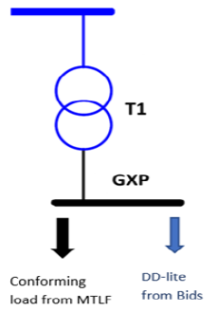
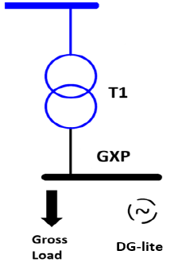
Recasting dispatch-lite for demand and generation
Eligible could be based on system operator assessing need for real-time telemetry
  if telemetry exists should be full DD or offered generation
  consider security risk to system → no telemetry = no visibility in real-time
    consider MW limits at each node and each electrical region
Using MW limits would avoid the cost of changing MTLF to account for lack of telemetry
GXP Load = T1 load
minus DD-lite bid MW
GXP Load = T1 load
plus DG-lite offer MW

Slide 59
Recasting dispatch-lite for demand and generation
Compliance assessed monthly after the fact from metered data
  not a breach to say no to dispatch notification
  provided correctly advised and all notifications followed otherwise
Continued eligibility depends on how often saying ‘no’
  something like a ‘three-strikes rule’ across a month, a quarter, etc

Slide 60
Recasting dispatch-lite for demand and generation
The system operator’s dispatch service enhancement (DSE) project is a key enabler:
  dispatch-lite a pair of new dispatch products
    dispatchable-demand-lite (DD-lite) and distributed-generation-lite (DG-lite)
Implementing dispatch-lite while ‘the hood is up’ for RTP likely to minimise costs (Market System, WITS)

Slide 61
Price Error Claims (PEC)
Presenter : Murray Henderson

Slide 62
PEC – current state
Created interim pricing period
Manually claimed (timebound)
Pricing manager assesses
Authority ultimate decision maker

Slide 63
PEC – RTP consultation
Q.17 Do you agree we should retain a process for addressing material pricing errors?
Yes – majority support
“Confidence in RTP could be undermined if available in ‘real-time’ means available ‘at a later time’ in the event of a material pricing error claim”
Materiality threshold
Notes:
Dig out original desire for PEC – suggest it wasn’t for $0.40 differences.

Slide 64


PEC – RTP consultation
Q.18 Which approach do your prefer for managing pricing errors: a manual process or automated checking?

Slide 65
PEC – RTP consultation
Q.18 Which approach do your prefer for managing pricing errors: a manual process or automated checking?
Post-schedule check (PSC)
80 validation rules
Appropriate outcomes

Slide 66

PEC – RTP consultation
Q.18 Which approach do your prefer for managing pricing errors: a manual process or automated checking?

Slide 67
PEC – RTP consultation
Q.19 If we retain a manual claim process for pricing errors under RTP, who should perform that role?
Pricing manager
System operator
The Authority
SO with EA ultimate decision maker
Notes:
Strike out options and then add EA comment.

Slide 68
PEC – RTP summary
Manual PEC retained
Materiality threshold
SO assess
EA ultimate decision maker
PSC pre-publication
checks to be socialised

Slide 69
PEC – RTP summary
Acutely aware of:
implications for “WYSIWYG”
need for expediency

Slide 70

Questions & Discussion & Wrap Up
Notes:
- Recap on thoughts for continued engagement

